Slide 1
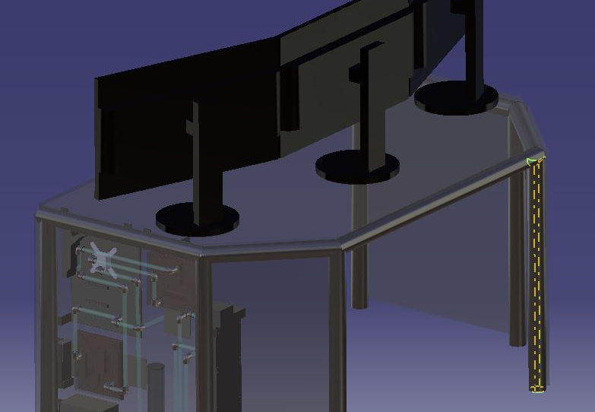
Desk Mounted Computer
Conner Krezman

Slide 2
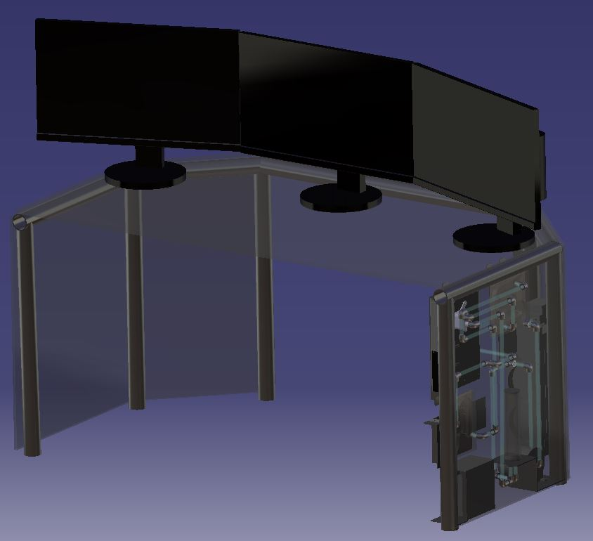
Objective
Create a desk with mounting points for a mother board, 2 GPUs, a radiator, a power supply, a water pump, and a water reservoir along with all the accompanied piping for cooling.

Slide 3
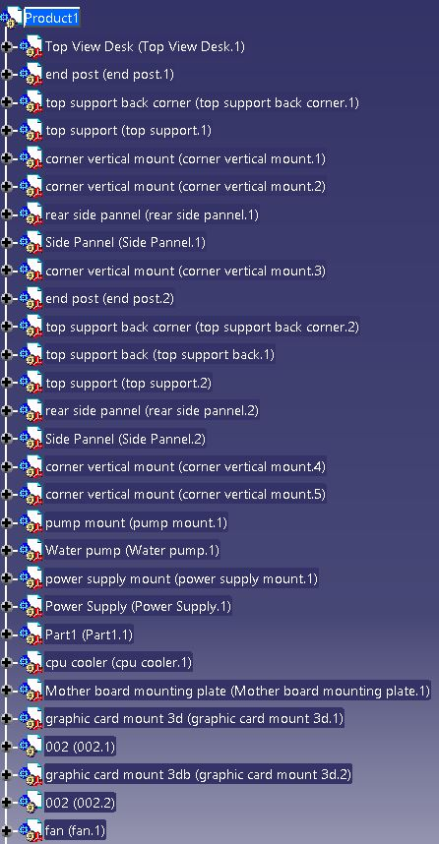
Bill of Materials
½-inch Tempered glass 60x34
Two 3/8-inch Tempered glass 28x23
2-inch, 1/8-inch wall, Pipe 24-feet
28 90-degree ½-inch elbow fittings
Two 1-inch polycarbonate Sheets 6.3x7.1
Two thin Copper Sheets 6.3x7.1
½-inch clear plastic tube 15-feet
2-inch, 1/8-inch thick, angle steel 8-inches
1/8-inch steel plate 10x13 and 22x4
2-inch clear plastic pipe 8-inches
2-inch steel round stock 4-inches
This does not include required computer parts. Dimensions are in inches.

Slide 4
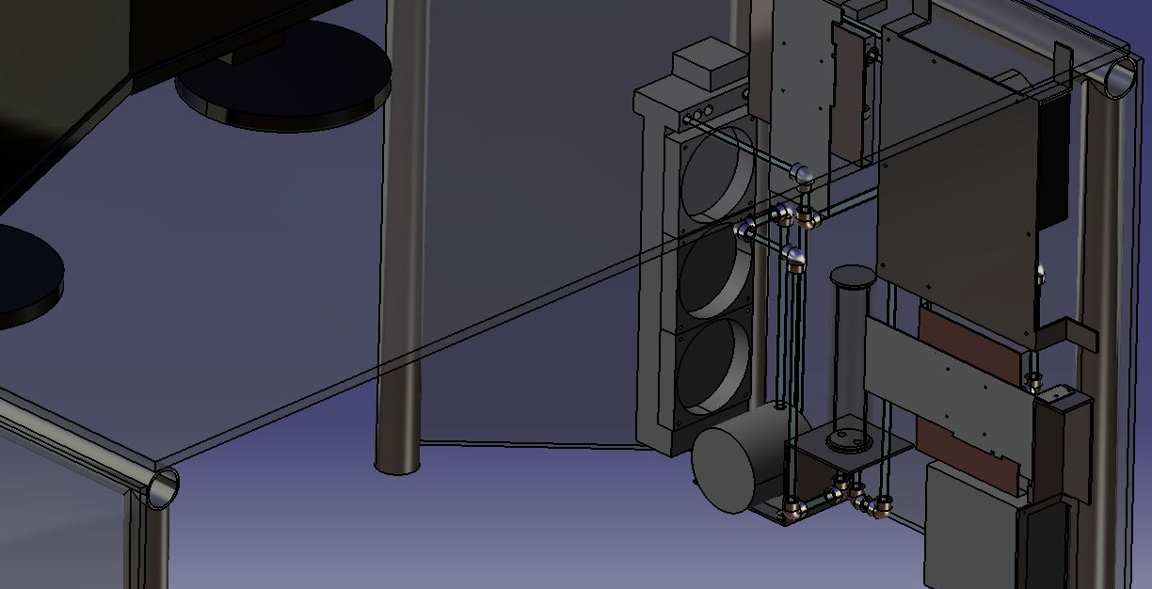

Slide 5
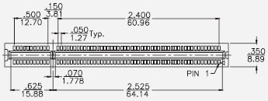
Design Lessons Learned
It is hard to find dimensions of manufactured computer parts. Especially the dimensions of the interior of the GPU where a liquid cooler would be mounted.
Debated about thickness of glass for the user surface, determined ½ inch safety glass will be sufficient as it can handle roughly 400 lbs at the furthest point from support
I created the water reservoir based on mentally picturing the volume of its capacity but when I implemented it into the assembly it was way to large, so I remade it smaller.
One other thing I contemplated was the order of the cooling tubes. Initially I was going to do a double loop system, going from the pump and reservoir to the GPUs and the CPU separately. After some discussion I determined that cavitation could be a problem with the splitting and joining of the pipe paths.

Slide 6
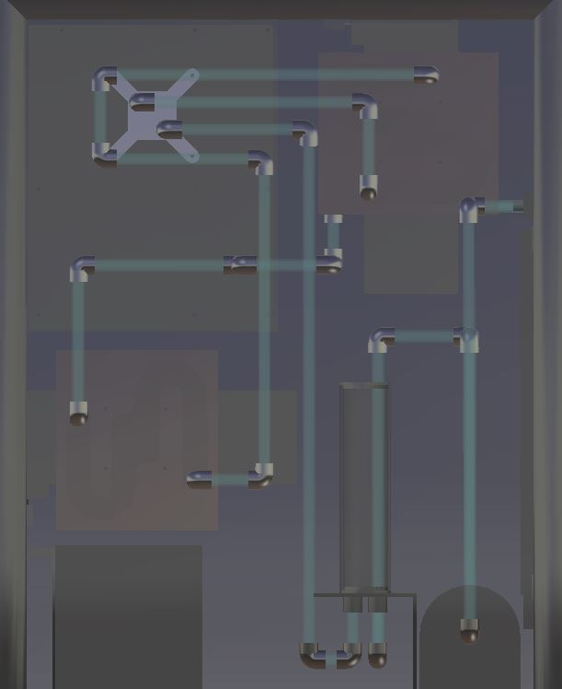
Catia Lessons Learned
I had some problems with constraints of cylinders since they have no edges. In the end I used contact constraint on their exterior to align them to what they were touching.
Naming of the cooling pipes was a problem since all of them are based from the same initial drawing. In the end, after each length change, I would rename the part, tube X.
It was tedious to try to connect two random points in space with only 90-degree bends without intersecting other parts or blocking other paths that I had not made yet.
Determining how long each of the tubes between the bends needs to be for the cooling system was another task I struggled with. In the end I was constraining the elbows at 90’s and in the correct location then measuring between them to create the tubes.

Slide 7
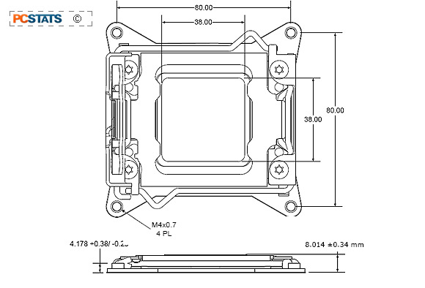
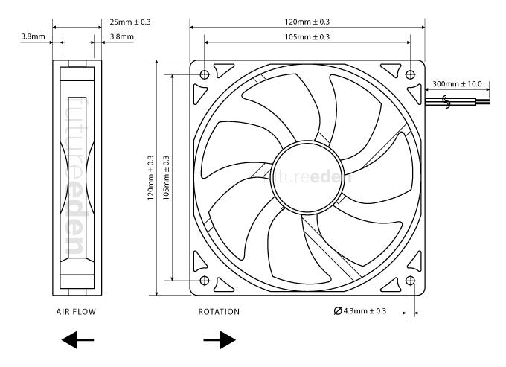
Resources Used
http://www.istarusa.com/documents/faq/faq82.pdf
http://www.interfacebus.com/Design_PCI_Card_Size.html
https://web.aub.edu.lb/pub/docs/atx_201.pdf
https://www.overclock.net/forum/18082-builds-logs-case-mods/1589018-guide-drawing-pci-e-atx-mitx-rear-io-bracket-custom-case.html
https://www.dullesglassandmirror.com/glass-weight-load-calculator

Slide 8
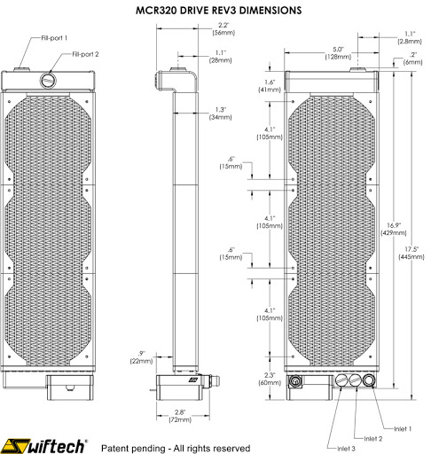
Resources Used Cont.

